Slide 1

Marlbrook, Little Dewchurch,
Wellington &St Martins Primary Schools
Camping Residential 2024
At Oaker Wood Leisure, Herefordshire
June 2024

Slide 2
School Camp Video
Click on the link above to watch video

Slide 3

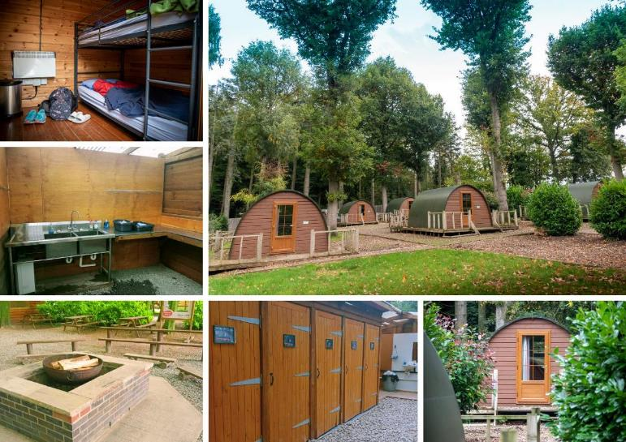
Camp Facilities

Slide 4
Please note that this is not a final itinerary and is subject to change. The itinerary is always finalised on arrival.
Day 1
11:00am Arrive at Oaker Wood
Camp Induction
Children will be divided into groups of 10-12. Groups will rotate around the activities throughout the residential. Groups will all do the same activities but not in the same order
12:00pm Packed Lunch provided by Students
1:00pm Gladiator & Quick Jump

Slide 5
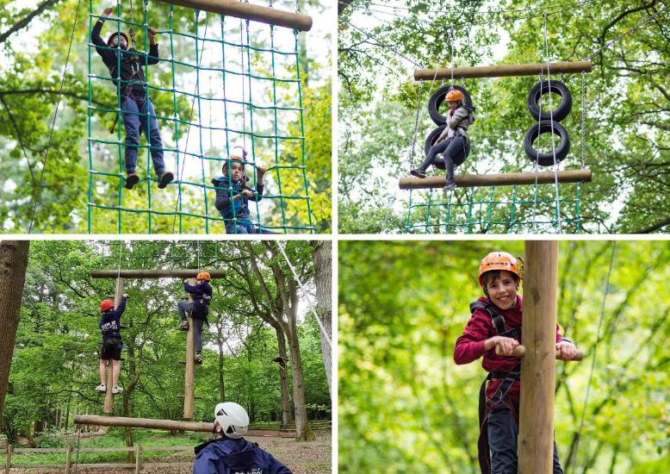
Gladiator

Slide 6
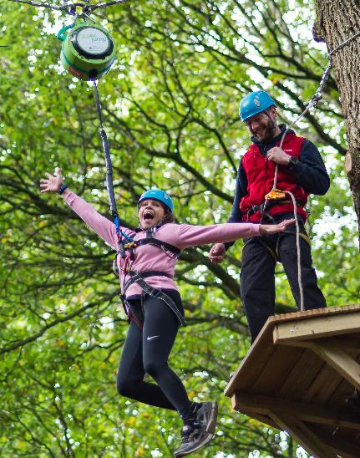
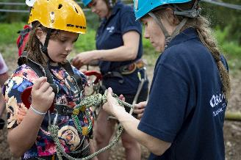
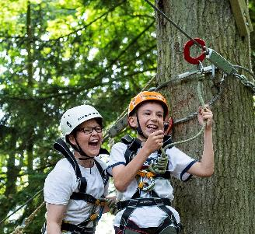
Quick Jump

Slide 7
Day 1
11:00am Arrive at Oaker Wood
Camp Induction
12:00pm Lunch
1:00pm Gladiator & Quick Jump
3:00pm Monkey Climb & Zip Wire

Slide 8
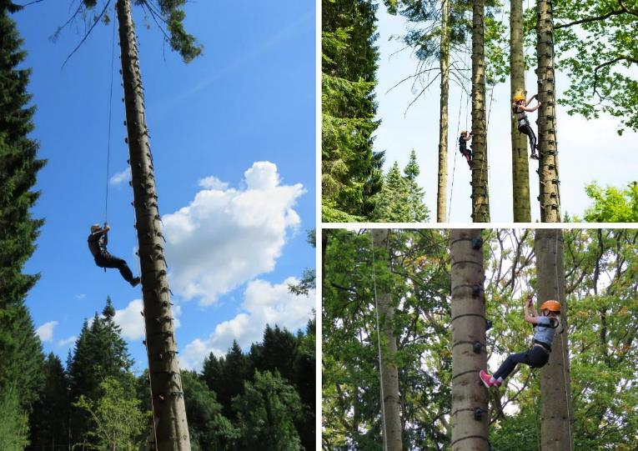
Monkey Climb

Slide 9
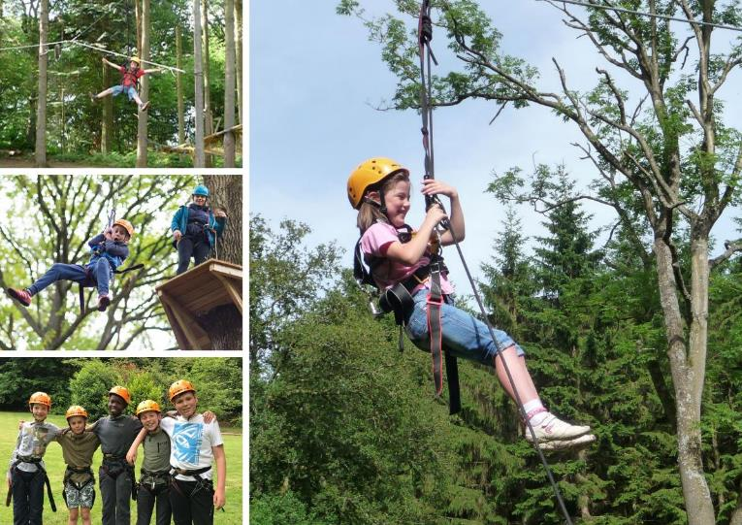
Zip Wire

Slide 10
Day 1
11:00am Arrive at Oaker Wood
Camp Induction
12:00pm Lunch
1:00pm Gladiator & Quick Jump
3:00pm Monkey Climb & Zip Wire
6:00pm Supper tbc
Camp Fire & Games

Slide 11
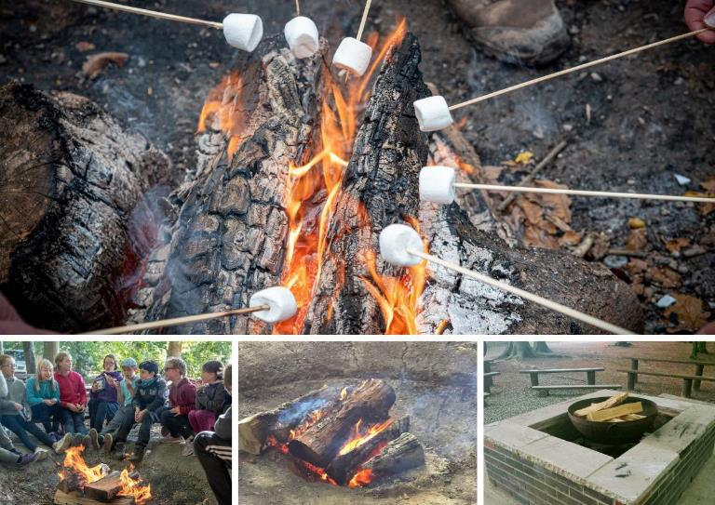
Evening Campfire

Slide 12
Day 2
8:30am Breakfast–Toast Cereal Fruit Juice
10:00am Pizza Making

Slide 13
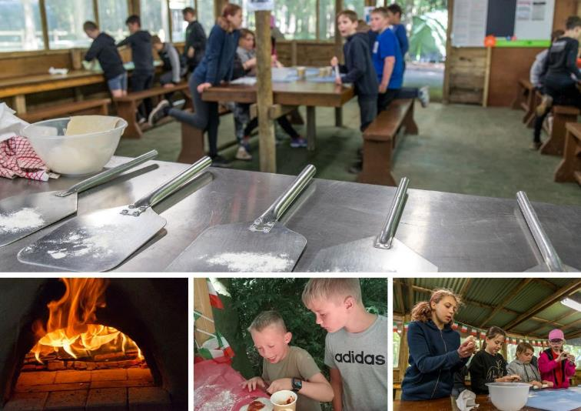
Pizza Making

Slide 14
Day 2
8:30am Breakfast–Toast Cereal Fruit Juice
10:00am Pizza Making
12:00pm Lunch-Hot Dogs Crisps Fruit
1:00pm Rafting

Slide 15
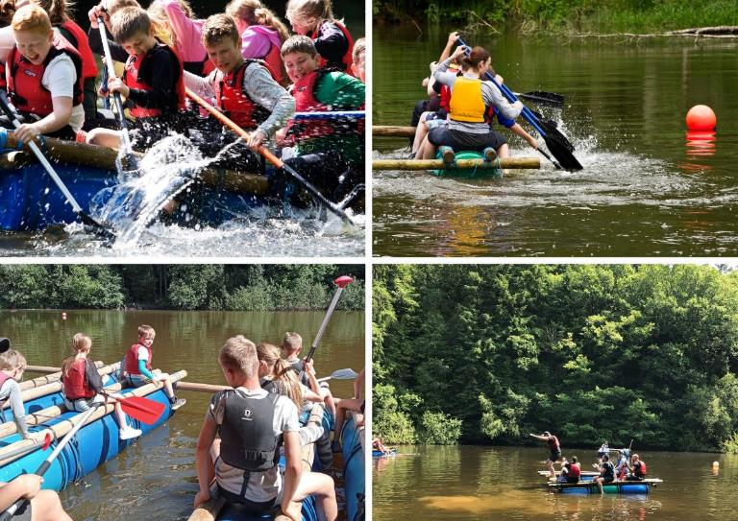
Rafting

Slide 16
Day 2
8:30am Breakfast–Toast Cereal Fruit Juice
10:00am Pizza Making
12:00pm Lunch-Hot Dogs Crisps Fruit
1:00pm Rafting
3:00pm Junior Paintball

Slide 17
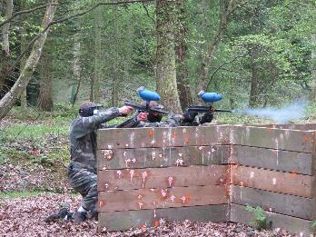
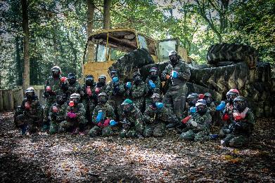
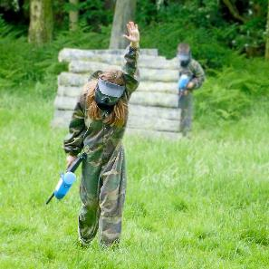
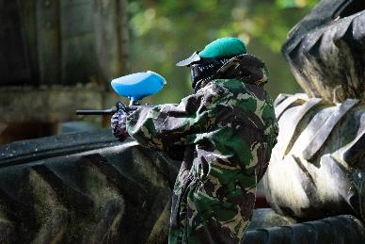
Junior Paintball

Slide 18
Day 2
8:30am Breakfast–Toast Cereal Fruit Juice
10:00am Pizza Making
12:00pm Lunch-Hot Dogs Crisps Fruit
1:00pm Rafting
3:00pm Junior Paintball
6:00pm Supper
Camp Fire & Games

Slide 19
Day 3
8:30am Breakfast
9:30pm Check out of camp
10:00am Woodland Navigational Trail

Slide 20
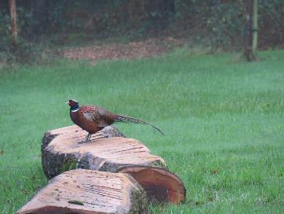

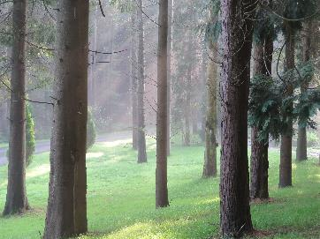
Woodland Navigational Trail

Slide 21
Day 3
8:30am Breakfast
9:30pm Check out of camp
10:00am Woodland Navigational Trail
12:00pm Lunch-Chicken Burger
Crisps & Choc Bar
1:00pm Depart Oaker Wood

Slide 22
What you need to bring
Sleeping bag and pillow
Plenty of changes of clothes – preferably tracksuits rather than jeans as these can become heavy when wet
Walking boots / wellies
Old trainers/ pumps - to wear in the lake or rafting session
Towel
Drinks bottle
Insect Repellent / sunscreen
Pyjamas, wash kit, toothbrush, shower gel, shampoo, hair ties
Torch (optional)
Waterproof coat
Any medication that you will need for your stay – Inhalers etc
Pocket Money for gift shop £5-10 (optional)

Slide 23
Meal Times
The school will be sent menu choices a few weeks before arrival. Everyone eats the same meal with the exception of dietary requirements
Breakfast – Cereals, Toast, Juice, Fruit
Lunch – e.g. Hot Dogs, Sandwiches, Burgers, Fruit, Crisps, Chocolate
Supper – e.g. Spaghetti Bolognaise, Chicken Curry, Chicken Nuggets & Chips, Pasta Bake, Lasagne

Slide 24

Social Media & Photos
We tend to share posts and photos from schools rather than taking our own photos due to permissions.
We find that parents enjoy seeing what the children are doing, so if your school is sharing photos, please do tag Oaker Wood.
If your schools does have permission for photos, please do let us know as if we know we are ok to take photos, we will do! Photos will often be shared on social media where appropriate.

Slide 25
Any Questions?

